Slide 1
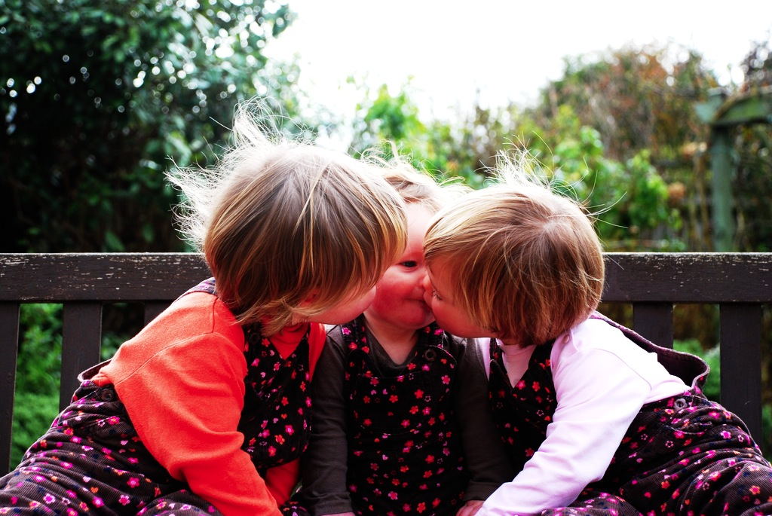

Joint Action
conceptual tools for scientific research

Slide 2
Joint action:
a goal-directed action, or something resembling one, comprising two or more agents’ goal-directed activities.

Slide 3
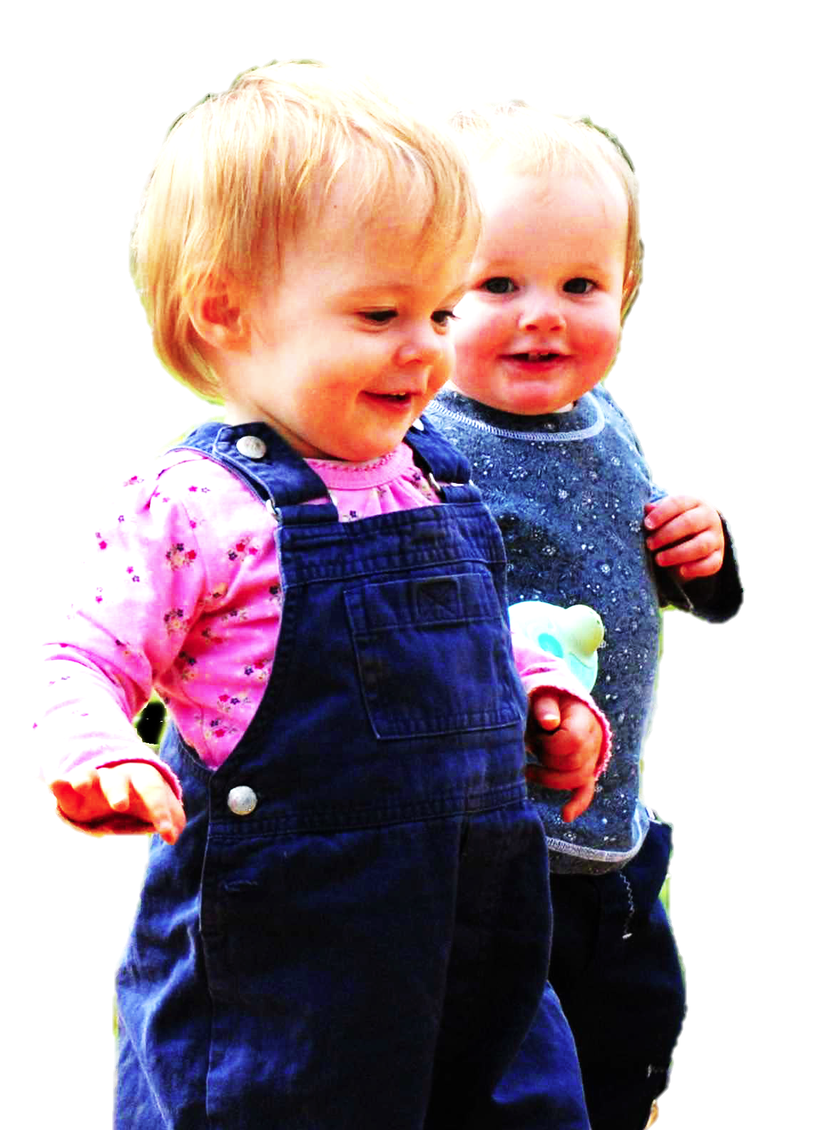
Joint action:
a goal-directed action, or something resembling one, comprising two or more agents’ goal-directed activities.
tidying up the toys together
(Behne et al 2005)
cooperatively pulling handles in sequence to make a dog-puppet sing
(Brownell et al 2006)
bouncing a ball on a large trampoline together
(Tomasello & Carpenter 2007)
pretending to row a boat together

Slide 4




Joint action:
a goal-directed action, or something resembling one, comprising two or more agents’ goal-directed activities.
“perception, action, and cognition are grounded in social interaction”
(Sebanz & Knoblich 2008)
“human cognitive abilities ... [are] built upon social interaction”
(Sinigaglia and Sparaci 2008)

Slide 5


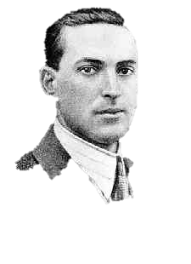
Joint action:
a goal-directed action, or something resembling one, comprising two or more agents’ goal-directed activities.
“participation in cooperative, cultural interactions ... leads children to construct uniquely powerful forms of cognitive representation.”
(Moll & Tomasello 2007)
“perception, action, and cognition are grounded in social interaction”
(Sebanz & Knoblich 2008)
“human cognitive abilities ... [are] built upon social interaction”
(Sinigaglia and Sparaci 2008)

Slide 6


Slide 7

first
shared intention
part

Slide 8
‘I take a collective action to involve a collective [shared] intention.’
(Gilbert 2006, p. 5)
‘The sine qua non of collaborative action is a joint goal [shared intention] and a joint commitment’
(Tomasello 2008, p. 181)
‘the key property of joint action lies in its internal component [...] in the participants’ having a “collective” or “shared” intention.’
(Alonso 2009, pp. 444-5)
‘Shared intentionality is the foundation upon which joint action is built.’
(Carpenter 2009, p. 381)

Slide 9
‘I take a collective action to involve a collective [shared] intention.’
(Gilbert 2006, p. 5)
‘The sine qua non of collaborative action is a joint goal [shared intention] and a joint commitment’
(Tomasello 2008, p. 181)
‘the key property of joint action lies in its internal component [...] in the participants’ having a “collective” or “shared” intention.’
(Alonso 2009, pp. 444-5)
‘Shared intentionality is the foundation upon which joint action is built.’
(Carpenter 2009, p. 381)
Notes:
shared intention is hard to characterise ... different philosophers have taken different approaches ... will focus on Bratman as this is a good starting point

Slide 10


Slide 11
What is shared intention?
Functional characterisation
Substantial account

Slide 12
What is shared intention?
Functional characterisation
shared intention serves to (a) coordinate activities, (b) coordinate planning and (c) structure bargaining
Substantial account

Slide 13
What is shared intention?
Functional characterisation
shared intention serves to (a) coordinate activities, (b) coordinate planning and (c) structure bargaining
Substantial account
We have a shared intention that we J =
“1. (a) I intend that we J and (b) you intend that we J
“2. I intend that we J in accordance with and because of la, lb, and meshing subplans of la and lb; you intend [likewise] …
“3. 1 and 2 are common knowledge between us”
(Bratman 1993: View 4)

Slide 14
What is shared intention?
Functional characterisation
shared intention serves to (a) coordinate activities, (b) coordinate planning and (c) structure bargaining
Substantial account
We have a shared intention that we J =
“1. (a) I intend that we J and (b) you intend that we J
“2. I intend that we J in accordance with and because of la, lb, and meshing subplans of la and lb; you intend [likewise] …
“3. 1 and 2 are common knowledge between us”
(Bratman 1993: View 4)
{
Intentions about intentions

Slide 15
What is shared intention?
Functional characterisation
shared intention serves to (a) coordinate activities, (b) coordinate planning and (c) structure bargaining
Substantial account
We have a shared intention that we J =
“1. (a) I intend that we J and (b) you intend that we J
“2. I intend that we J in accordance with and because of la, lb, and meshing subplans of la and lb; you intend [likewise] …
“3. 1 and 2 are common knowledge between us”
(Bratman 1993: View 4)
{
Intentions about intentions
{
Knowledge of others’ knowledge of intentions about intentions

Slide 16
“philosophers ... postulate complex intentional structures that often seem to be beyond human cognitive ability in real-time social interactions.”
(Knoblich & Sebanz 2008: 2022)
What is shared intention?
Functional characterisation
shared intention serves to (a) coordinate activities, (b) coordinate planning and (c) structure bargaining
Substantial account
We have a shared intention that we J =
“1. (a) I intend that we J and (b) you intend that we J
“2. I intend that we J in accordance with and because of la, lb, and meshing subplans of la and lb; you intend [likewise] …
“3. 1 and 2 are common knowledge between us”
(Bratman 1993: View 4)
{
Intentions about intentions
{
Knowledge of others’ knowledge of intentions about intentions

Slide 17
“philosophers ... postulate complex intentional structures that often seem to be beyond human cognitive ability in real-time social interactions.”
Functional characterisation
shared intention serves to (a) coordinate activities, (b) coordinate planning and (c) structure bargaining
Substantial account
We have a shared intention that we J =
“1. (a) I intend that we J and (b) you intend that we J
“2. I intend that we J in accordance with and because of la, lb, and meshing subplans of la and lb; you intend [likewise] …
“3. 1 and 2 are common knowledge between us”
(Bratman 1993: View 4)
{
Intentions about intentions
{
Knowledge of others’ knowledge of intentions about intentions

Slide 18
travel
buy
Jon
Notes:
same thing for Al --- want to surprise him and so plan to go to the shops, buy him some grappa and give it to him. Either plan is fine by itself. but they can’t both be executed by me because I don’t have enough money for both.

Slide 19
travel
buy
Jon
travel
buy
Al
Notes:
same thing for Al --- want to surprise him and so plan to go to the shops, buy him some grappa and give it to him. Either plan is fine by itself. but they can’t both be executed by me because I don’t have enough money for both.

Slide 20
travel
buy
Jon
travel
buy
Al
Notes:
same thing for Al --- want to surprise him and so plan to go to the shops, buy him some grappa and give it to him. Either plan is fine by itself. but they can’t both be executed by me because I don’t have enough money for both.

Slide 21
“philosophers ... postulate complex intentional structures that often seem to be beyond human cognitive ability in real-time social interactions.”
Functional characterisation
shared intention serves to (a) coordinate activities, (b) coordinate planning and (c) structure bargaining
Substantial account
We have a shared intention that we J =
“1. (a) I intend that we J and (b) you intend that we J
“2. I intend that we J in accordance with and because of la, lb, and meshing subplans of la and lb; you intend [likewise] …
“3. 1 and 2 are common knowledge between us”
(Bratman 1993: View 4)
{
Intentions about intentions
{
Knowledge of others’ knowledge of intentions about intentions

Slide 22
“philosophers ... postulate complex intentional structures that often seem to be beyond human cognitive ability in real-time social interactions.”
“philosophers ... postulate complex intentional structures that often seem to be beyond human cognitive ability in real-time social interactions.”
(Knoblich & Sebanz 2008: 2022)
Functional characterisation
shared intention serves to (a) coordinate activities, (b) coordinate planning and (c) structure bargaining
Substantial account
We have a shared intention that we J =
“1. (a) I intend that we J and (b) you intend that we J
“2. I intend that we J in accordance with and because of la, lb, and meshing subplans of la and lb; you intend [likewise] …
“3. 1 and 2 are common knowledge between us”
(Bratman 1993: View 4)
{
Intentions about intentions
{
Knowledge of others’ knowledge of intentions about intentions

Slide 23
1. All (significant) joint actions require shared intention.
2. Shared intention requires conceptual sophistication and is typically cognitively demanding.

Slide 24
1. All (significant) joint actions require shared intention.
2. Shared intention requires conceptual sophistication and is typically cognitively demanding.

Slide 25
1. All (significant) joint actions require shared intention.
2. Shared intention requires conceptual sophistication and is typically cognitively demanding.

Slide 26
tidying up the toys together
(Behne et al 2005)
cooperatively pulling handles in sequence to make a dog-puppet sing
(Brownell et al 2006)
bouncing a ball on a large trampoline together
(Tomasello & Carpenter 2007)
pretending to row a boat together

Slide 27
change nappy
Notes:
Typically an action involves many different components other than intention. Let me just lay out a crude picture of an intentional action to fix terminology. [...] Given this picture It’s clearly a prejudice to think that joint action depends on meshing of intentions rather than meshing at other levels. My suggestion, then, is that if we want to understand potential roles of joint action in evolution or in development, we should focus on meshing not of intentions but of motor actions and goals.

Slide 28
change nappy
plans
prepare infant
prepare nappy
assemble

Slide 29
change nappy
plans
prepare infant
prepare nappy
assemble
goals
strip clothes
clean bum
open
place under
close studs

Slide 30
change nappy
plans
prepare infant
prepare nappy
assemble
goals
strip clothes
clean bum
open
place under
close studs
… /reach X/ /grasp X/ /grasp Y/ /pull Y/ /scoop X/ /Y out of X/ …
motor action

Slide 31
change nappy
plans
prepare infant
prepare nappy
assemble
goals
strip clothes
clean bum
open
place under
close studs
… /reach X/ /grasp X/ /grasp Y/ /pull Y/ /scoop X/ /Y out of X/ …
motor action
… [reach-left-hand X] [left-wholehand-grasp X] [right-wholehand-grasp …

Slide 32


change nappy
plans
prepare infant
prepare nappy
assemble
goals
strip clothes
clean bum
open
place under
close studs
… /reach X/ /grasp X/ /grasp Y/ /pull Y/ /scoop X/ /Y out of X/ …
motor action
… [reach-left-hand X] [left-wholehand-grasp X] [right-wholehand-grasp …
motion
Image adapted from: Rizzolatti, Giacomo, and Giuseppe Luppino. 2001. The Cortical Motor System. Neuron 31, no. 6 (September 27): 889-901. doi:10.1016/S0896-6273(01)00423-8.

Slide 33
mirroring for coordination?

Slide 34
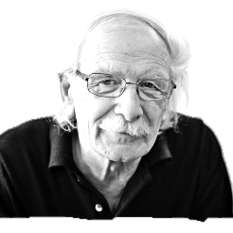
“Why should the motor system encode the goals of actions performed by others? ... the interpretation of this finding was that they allow the observer to understand directly the goal of the actions of others.”
(Rizzolatti and Sinigaglia 2010)
Notes:
This mapping provides “the building blocks upon which the intentional understanding of another’s actions can be constructed.” (Sinigaglia 2008) = This is the question

Slide 35
“Why should the motor system encode the goals of actions performed by others? ... the interpretation of this finding was that they allow the observer to understand directly the goal of the actions of others.”
(Rizzolatti and Sinigaglia 2010)
Notes:
This mapping provides “the building blocks upon which the intentional understanding of another’s actions can be constructed.” (Sinigaglia 2008) = This is the question

Slide 36
“... mirror-based understanding ... [observed] acts are mapped onto the vocabulary of the observer’s own motor acts.”
(Sinigaglia 2008)
“The primary function of such a mapping [is] ... to allow the observed to ... understand the intentional meaning of another’s action.”
(Sinigaglia & Sparaci 2008)
Notes:
This mapping provides “the building blocks upon which the intentional understanding of another’s actions can be constructed.” (Sinigaglia 2008) = This is the question

Slide 37
“... mirror-based understanding ... [observed] acts are mapped onto the vocabulary of the observer’s own motor acts.”
(Sinigaglia 2008)
“The primary function of such a mapping [is] ... to allow the observed to ... understand the intentional meaning of another’s action.”
(Sinigaglia & Sparaci 2008)
Notes:
This mapping provides “the building blocks upon which the intentional understanding of another’s actions can be constructed.” (Sinigaglia 2008) = This is the question

Slide 38
recognition of motor intentional meaning
mirroring motor cognition

Slide 39
ascription of belief, desire, intention ...
recognition of motor intentional meaning
mirroring motor cognition

Slide 40
shared intention
ascription of belief, desire, intention ...
own beliefs, desires, intentions, ...
recognition of motor intentional meaning
mirroring motor cognition

Slide 41
coordinated motor planning
shared intention
ascription of belief, desire, intention ...
own beliefs, desires, intentions, ...
recognition of motor intentional meaning
mirroring motor cognition

Slide 42
coordinated motor planning
coordinated motor planning
shared intention
ascription of belief, desire, intention ...
own beliefs, desires, intentions, ...
recognition of motor intentional meaning
recognition of motor intentional meaning
mirroring motor cognition
mirroring motor cognition

Slide 43
case
co-representation
study

Slide 44
Shared Task Representations
(1) If a green ring appears, press the right button
(2) If a red ring appears, press the left button
(Sebanz et al 2003)
Notes:
This is an illustration of how there might be meshing capable of supporting joint action without shared intention.

Slide 45

Shared Task Representations
(1) If a green ring appears, press the right button
(2) If a red ring appears, press the left button
(Sebanz et al 2003)

Slide 46
Shared Task Representations
(1) If a green ring appears, press the right button
(2) If a red ring appears, press the left button
(Sebanz et al 2003)

Slide 47
Shared Task Representations
(1) If a green ring appears, press the right button
(2) If a red ring appears, press the left button
(Sebanz et al 2003)

Slide 48
Shared Task Representations
(1) If a green ring appears, press the right button
(2) If a red ring appears, press the left button
(Sebanz et al 2003)

Slide 49
If a green ring appears, press the right button
role of Agent2
If a finger pointing left appears, press the left button
role of Agent1
task representations

Slide 50
If a green ring appears, press the right button
action plan
role of Agent2
If a finger pointing left appears, press the left button
action plan
role of Agent1
task representations
action initiation

Slide 51
If a green ring appears, press the right button
action plan
role of Agent2
If a finger pointing left appears, press the left button
left button press
action plan
role of Agent1
task representations
action initiation
action

Slide 52
If a green ring appears, press the right button
action plan
[no action]
role of Agent2
my task is to press the right button
If a finger pointing left appears, press the left button
left button press
action plan
role of Agent1
task representations
action initiation
inhibition by knowledge
action
Notes:
say that shared task representations differ from shared intentions in that (a) they coordinate motor activities rather than practical deliberation; and, relatedly, (b) having them doesn’t seem to depend on wanting or intending to act together, or even on knowing that you are.

Slide 53
second
part
a puzzle

Slide 54
What is the relation between a joint action and the goal (or goals) to which it is directed?

Slide 55

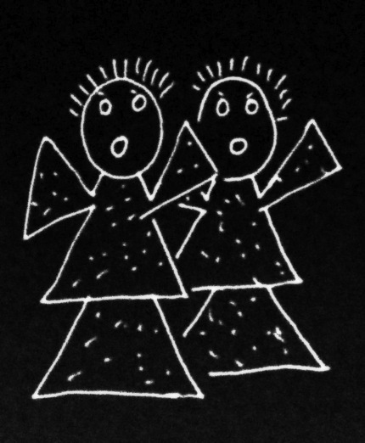
What is the relation between a joint action and the goal (or goals) to which it is directed?

Slide 56
What is the relation between a joint action and the goal (or goals) to which it is directed?

Slide 57
amuse
act
smash
free
act
alarm

Slide 58
amuse
act
smash
free
act
alarm

Slide 59
amuse
act
smash
free
act
shared intention
alarm

Slide 60
amuse
act
smash
free
act
shared intention
OR
???
alarm

Slide 61
G is a distributive goal: it is an outcome to which each agent’s activities are individually directed and it is possible that: all agents succeed relative to this outcome.

Slide 62
G is a distributive goal: it is an outcome to which each agent’s activities are individually directed and it is possible that: all agents succeed relative to this outcome.
G is a collective goal
(a) it is a distributive goal;
(b) the agents’ activities are coordinated; and
(c) this type of outcome would normally be facilitated by this type of coordination.

Slide 63
G is a distributive goal: it is an outcome to which each agent’s activities are individually directed and it is possible that: all agents succeed relative to this outcome.
G is a collective goal
(a) it is a distributive goal;
(b) the agents’ activities are coordinated; and
(c) this type of outcome would normally be facilitated by this type of coordination.

Slide 64
G is a distributive goal: it is an outcome to which each agent’s activities are individually directed and it is possible that: all agents succeed relative to this outcome.
G is a shared goal
G is a collective goal
(a) it is a distributive goal;
(b) the agents’ activities are coordinated; and
(c) this type of outcome would normally be facilitated by this type of coordination.
Each agent expects each of the other agents to perform activities directed to the goal.
Each agent expects the goal to occur as a common effect of all their goal-directed actions.

Slide 65


Slide 66
“participation in cooperative, cultural interactions ... leads children to construct uniquely powerful forms of cognitive representation.”
(Moll & Tomasello 2007)
“perception, action, and cognition are grounded in social interaction”
(Sebanz & Knoblich 2008)
“human cognitive abilities ... [are] built upon social interaction”
(Sinigaglia and Sparaci 2008)

Slide 67
“... the crucial role played by the motor system in providing the building blocks upon which more sophisticated social cognitive abilities can be built.”
(Gallese et al 2009)
Notes:
... How does this work? Different route if we think of the motor system as providing the coordination necessary for joint action where engaging in joint action itself makes possible, or facilitates, the emergence of further forms of cognition

Slide 68

‘Ayesha and Beatrice between them lifted the table’

Slide 69
‘Ayesha and Beatrice between them lifted the table’
‘Left Leg and Right Leg between them supported the table’
‘Ayesha and Beatrice between them lifted the table intentionally’

Slide 70
‘Ayesha and Beatrice between them lifted the table’
‘Left Leg and Right Leg between them supported the table’
‘Ayesha and Beatrice between them lifted the table intentionally’

Slide 71
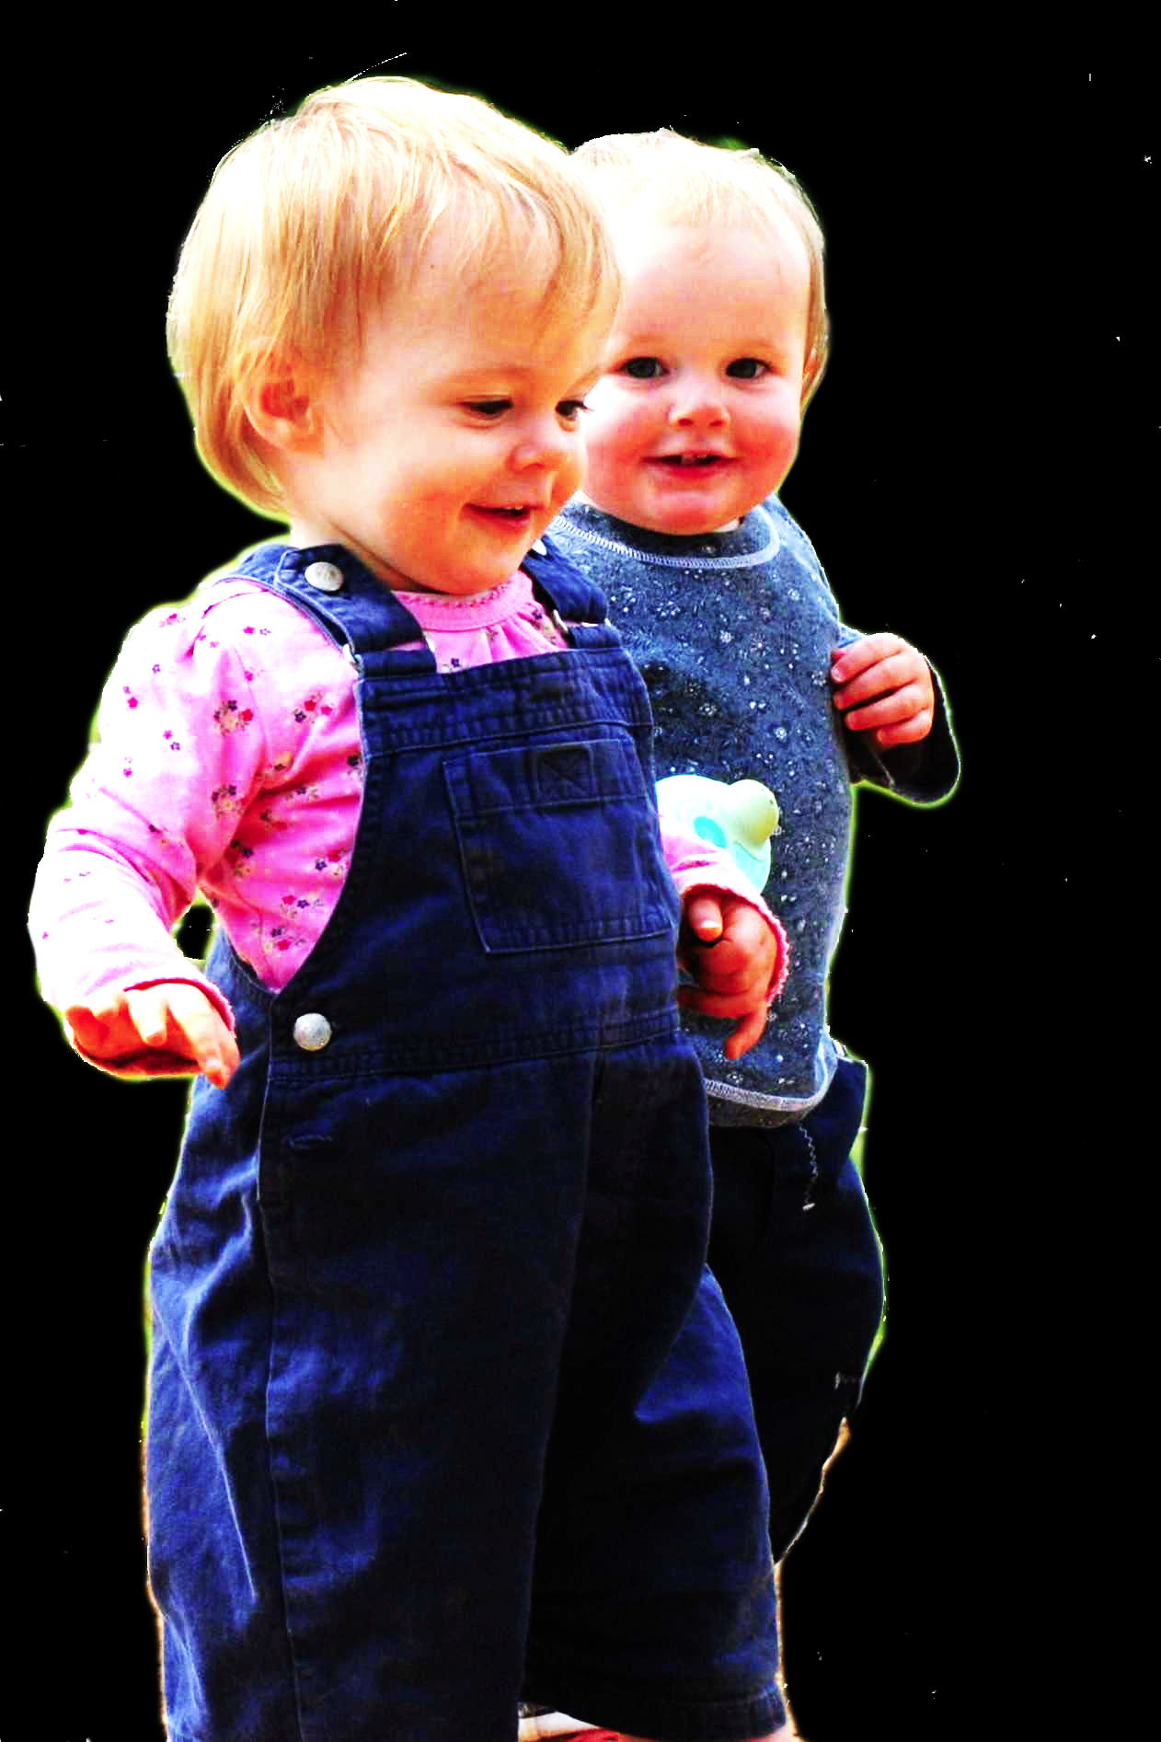
application
Notes:
This is an overview of the project and its aims

Slide 72


failed reach
point
source: Hare & Tomasello (2004)
Notes:
this illustrates problem of identifying particular goals of action

Slide 73
The problem of opaque means

Slide 74
your-goal-is-my-goal

Slide 75
your-goal-is-my-goal
1. We are about to engage in some joint action* or other
2. I am not about to change my goal.
Therefore:
3. Your actions also will be directed to this goal.
[*in at least the minimal sense associated with distributive goals]

Slide 76
failed reach
point
source: Hare & Tomasello (2004)

Slide 77
failed reach
point
source: Hare & Tomasello (2004)
“to understand pointing, the subject needs to understand more than the individual goal-directed behaviour. She needs to understand that ... the other attempts to communicate to her ... and ... the communicative intention behind the gesture”
(Moll & Tomsello 2007)

Slide 78
Csibra’s ‘two stances’:
Teleological and referential action interpretation ‘rely on different kinds of action understanding’
These are initially two distinct ‘action interpretation systems’ ; they come together later in development
Csibra (2003, p. 456)

Slide 79
minimal mindreading abilities
ability to share goals
understanding communicative intent
other stuff
communication by language
other stuff
full mindreading abilities

Slide 81
‘Ayesha and Beatrice between them lifted the table’

Slide 82
‘Ayesha and Beatrice between them lifted the table’
‘Left Leg and Right Leg between them supported the table’
‘Ayesha and Beatrice between them lifted the table intentionally’

Slide 83
‘Ayesha and Beatrice between them lifted the table’
‘Left Leg and Right Leg between them supported the table’
‘Ayesha and Beatrice between them lifted the table intentionally’

Slide 85
awareness of joint-ness
at least one of the agents knows that they are not acting individually; she or they have ‘a conception of themselves as contributors to a collective end.’
awareness of others’ agency
at least one of the agents is aware of one or more of the others as an intentional agent.
awareness of others’ states or commitments
at least one of the agents who are F-ing is aware of, or has individuating beliefs about, some of the others’ intentions, beliefs or commitments concerning F.

Slide 86
awareness of joint-ness
at least one of the agents knows that they are not acting individually; she or they have ‘a conception of themselves as contributors to a collective end.’
awareness of others’ agency
at least one of the agents is aware of one or more of the others as an intentional agent.
awareness of others’ states or commitments
at least one of the agents who are F-ing is aware of, or has individuating beliefs about, some of the others’ intentions, beliefs or commitments concerning F.

Slide 87
awareness of joint-ness
at least one of the agents knows that they are not acting individually; she or they have ‘a conception of themselves as contributors to a collective end.’
awareness of others’ agency
at least one of the agents is aware of one or more of the others as an intentional agent.
awareness of others’ states or commitments
at least one of the agents who are F-ing is aware of, or has individuating beliefs about, some of the others’ intentions, beliefs or commitments concerning F.

Slide 88
awareness of joint-ness
at least one of the agents knows that they are not acting individually; she or they have ‘a conception of themselves as contributors to a collective end.’
awareness of others’ agency
at least one of the agents is aware of one or more of the others as an intentional agent.
awareness of others’ states or commitments
at least one of the agents who are F-ing is aware of, or has individuating beliefs about, some of the others’ intentions, beliefs or commitments concerning F.

Slide 89
awareness of joint-ness
at least one of the agents knows that they are not acting individually; she or they have ‘a conception of themselves as contributors to a collective end.’
awareness of others’ agency
at least one of the agents is aware of one or more of the others as an intentional agent.
awareness of others’ states or commitments
at least one of the agents who are F-ing is aware of, or has individuating beliefs about, some of the others’ intentions, beliefs or commitments concerning F.
Joint action:
a goal-directed action, or something resembling one, comprising two or more agents’ goal-directed activities.

Slide 90
awareness of joint-ness
at least one of the agents knows that they are not acting individually; she or they have ‘a conception of themselves as contributors to a collective end.’
awareness of others’ agency
at least one of the agents is aware of one or more of the others as an intentional agent.
awareness of others’ states or commitments
at least one of the agents who are F-ing is aware of, or has individuating beliefs about, some of the others’ intentions, beliefs or commitments concerning F.
Joint action:
a goal-directed action, or something resembling one, comprising two or more agents’ goal-directed activities.

Slide 91
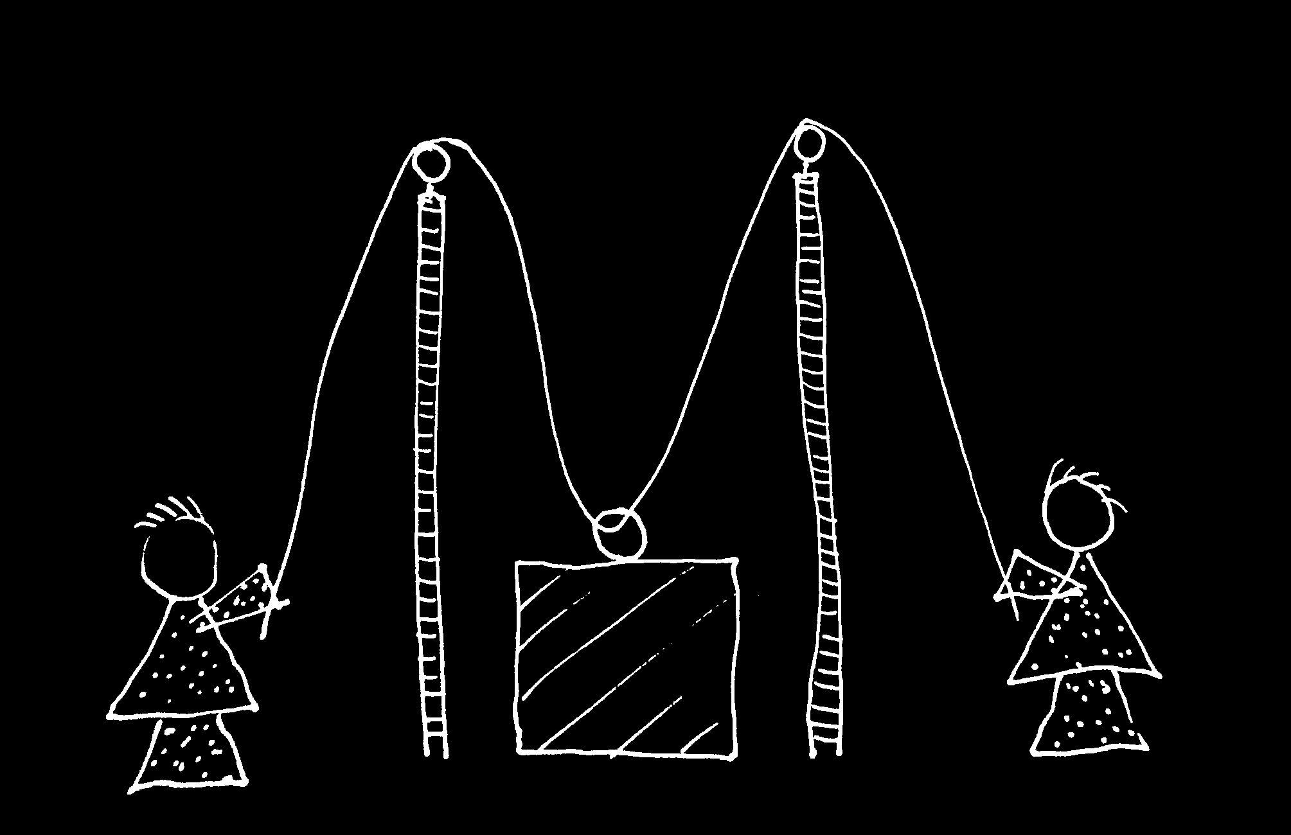
cf. Vesper et al (Neural Networks 2010)

Slide 92


Slide 93
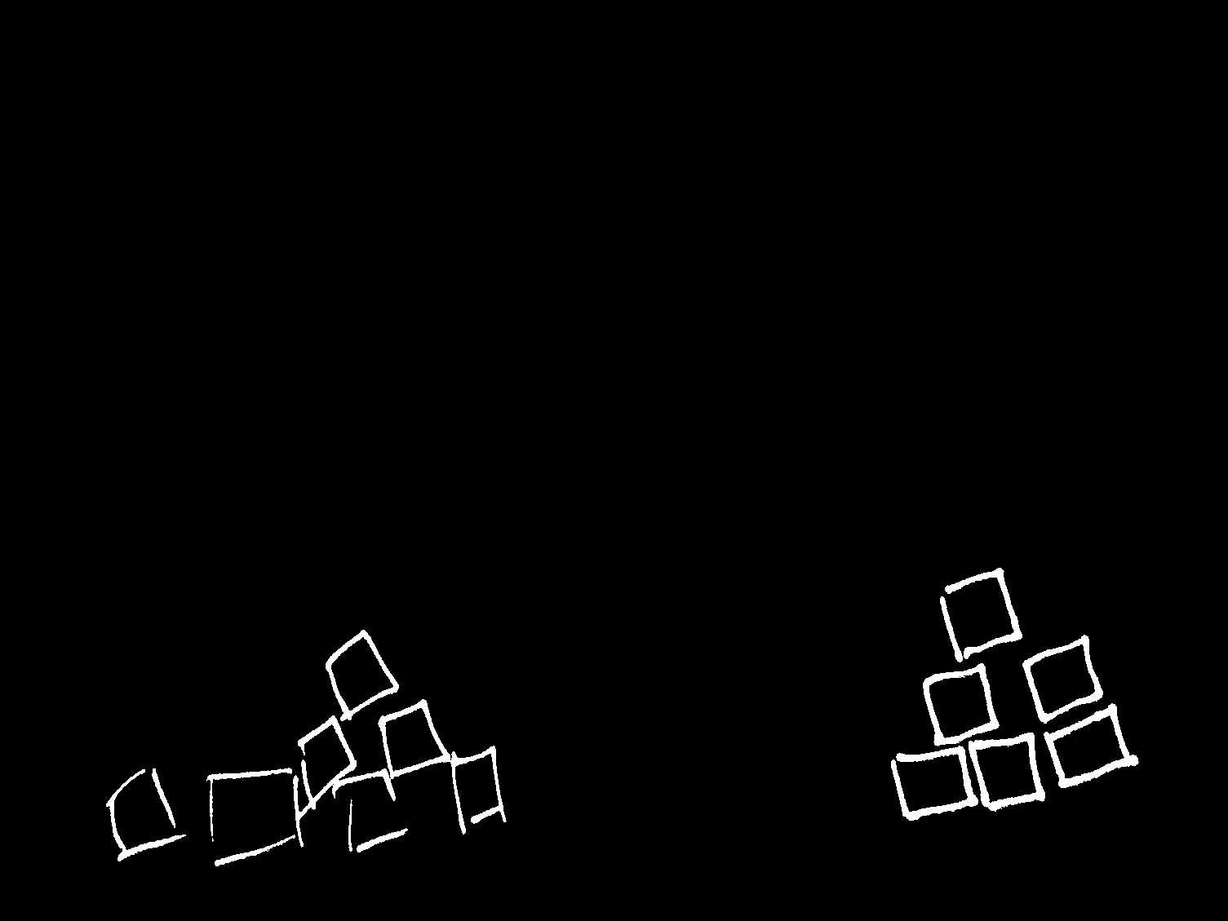

Slide 95
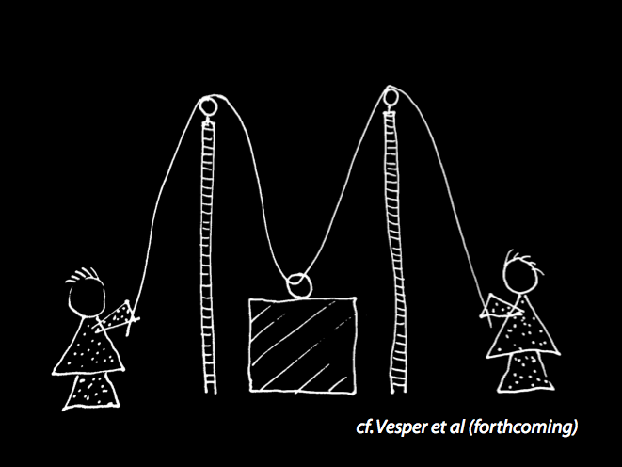
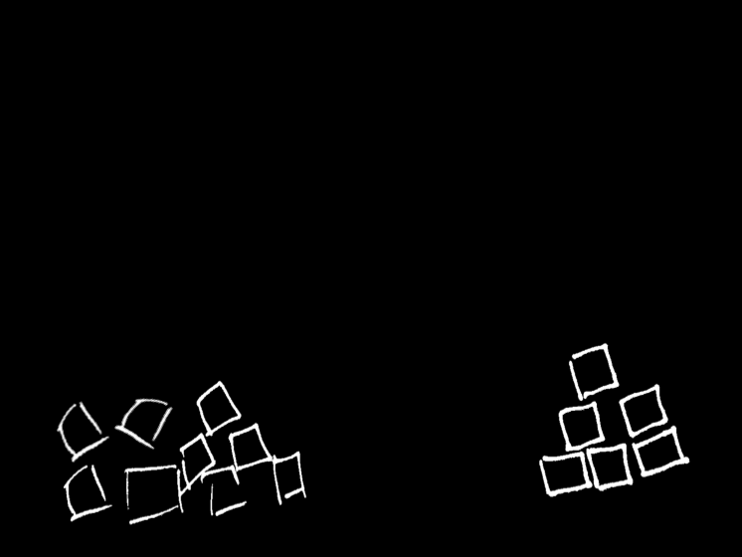

Slide 97
‘Ayesha and Beatrice between them lifted the table’

Slide 98
‘Ayesha and Beatrice between them lifted the table’
‘Left Leg and Right Leg between them supported the table’
‘Ayesha and Beatrice between them lifted the table intentionally’

Slide 99
‘Ayesha and Beatrice between them lifted the table’
‘Left Leg and Right Leg between them supported the table’
‘Ayesha and Beatrice between them lifted the table intentionally’

